Slide 1
Restaurant Rating Prediction

Slide 2
Objective:
Development of a predictive model for predicting Restaurant’s Rating. The model will determine how much rating a restaurant deserve according to their services, facilities, food, cost , etc.
Benefits:
Detection of upcoming Restaurants Rating.
Gives better insight of customers base.
Helps in developing new Restaurant.
Improvising Restaurants that have low ratings.

Slide 3
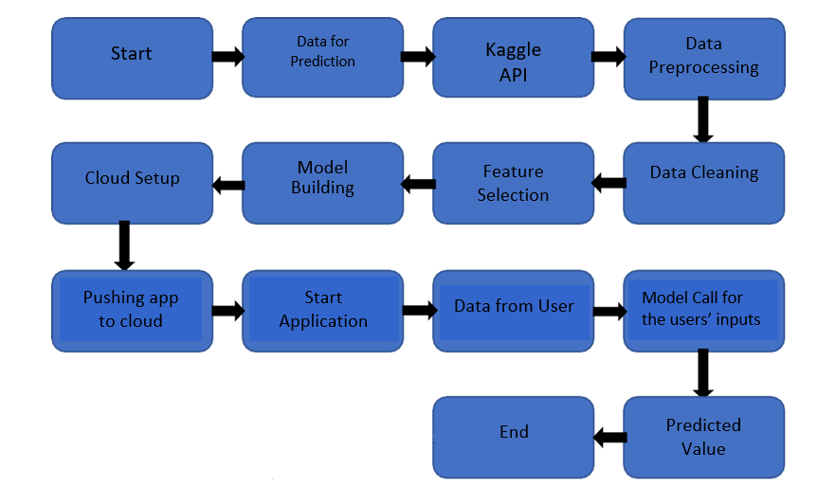
Architecture

Slide 4
Model Training:
Data Preprocessing
Performing EDA to get insight of data like identifying distribution , outliers ,trend
among data etc.
Check for null values in the columns. If present impute the null values.
Encode the categorical values with numeric values.
Perform Standard Scalar to scale down the values.

Slide 5
Model Selection –
After the raw data is cleaned, we find the best model. As the target variable is continuous, we use regression type of algorithms. We evaluate accuracy score for many regression algorithms. From that we choose the best working model. We implement that best model with the real-time data.

Slide 6
Prediction:
We perform the Validation operations ,data transformation and data insertion on them.
We perform data pre-processing techniques on it.
We perform scaling, handle categorical and NAN values from the real data .
Once the prediction is done, the predictions are displayed to the user.

Slide 7
Q & A:
Q1) What’s the source of data?
The data for training is fetched from the Bangalore Zomato Dataset
Q 2) What was the type of data?
The data was the combination of numerical and Categorical values.
Q 3) What’s the complete flow you followed in this Project?
Refer slide 3rd for better Understanding

Slide 8
Q 4) What techniques were you using for data pre-processing?
Removing unwanted attributes
Visualizing relation of independent variables with each other and output variables
Checking and changing Distribution of continuous values
Removing outliers
Cleaning data and imputing if null values are present.
Converting categorical data into numeric values.
Scaling the data

Slide 9
Q 5) How training was done or what models were used?
The scaling was performed over training and testing data
Algorithms like linear regression, Ridge, Lasso, Random Forest were used. Finally, Random Forest model was used for prediction.
Q 6) How Prediction was done?
The testing data are entered by the user. We Perform the same life cycle till the data is scaled .Then on the basis of Random Forest Algorithm, model is loaded and perform prediction. In the end we get result rating data of predictions.

Slide 10
Q 7) What are the different stages of deployment?
When the model is ready we deploy it in Azure environment .

